Slide 1
Strength in Numbers: Maximizing Success Through Study Groups
2025
By Paulette Bee and Melissa Bruton

Slide 2
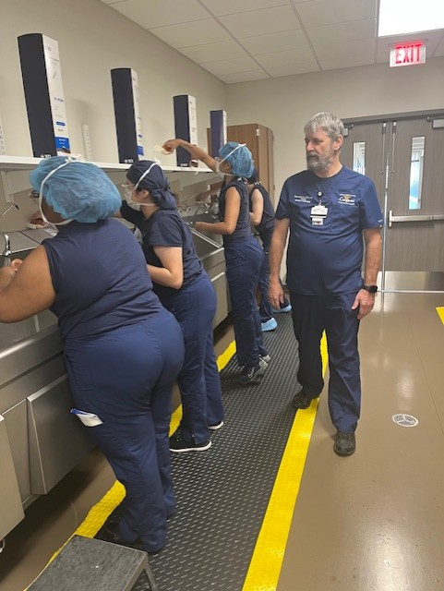
We don’t see things as they are; we see them as we are.
2025
Anaïs Nin

Slide 3
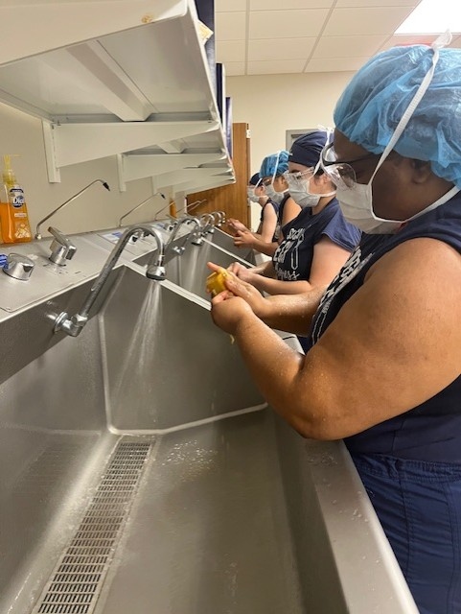
What does this mean to you as a professor?
What do you think this means to your students?

Slide 4
Let’s think differently?
2025

Slide 5
What assumptions do professors have about students?
2025
Do the homework and turn it in on time
Read the assignments
Practice the skills
Be engaged in class
Be prepared for lab
Be on time to class
Find connection and meaning to what you are studying

Slide 6
What’s the reality for the students?
2025
Students are working 30+ hours a week in jobs that do not support the demands of college.
Students are parents taking care of young children.
Students are taking care of elderly people.
Students are unprepared for the rigors of academic life.
Students may not have strong language skills.
Students may have stop outs in their academic journeys. (medical, family moving, covid, change in schools and are coming back)

Slide 7
Are we on the same page?
2025

Slide 8
Colaborative Learning
2025
Study groups encourage collaboration among peers, allowing students to share perspectives, explain concepts to one another, and co-create knowledge. This process enhances understanding and retention of information.
Paradigms

Slide 9
How did you learn as a college student?
2025
Ask yourself these QUESTIONS:
How did you do your first semester in school?
Was college a priority for you?
Or did you have other factors to juggle?
Did you have a support system in place?
Or did you create a support system?

Slide 10
Active Engagement
2025
Students in study groups are actively engaged in the learning process rather than passively receiving information. They discuss, question, and explore material together, which fosters deeper comprehension.
Paradigms

Slide 11
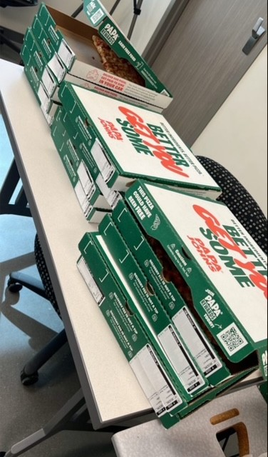
What can we do to encourage study groups?
2025
Lunch and Learn
provide pizza and drinks

Slide 12
Social Constructivism
2025
This paradigm emphasizes that learning is a social process. Study groups provide a context for students to engage with each other, helping them to construct new knowledge through dialogue and interaction.
Paradigms

Slide 13
Social Constructivism
In the framework of social constructivism, learning transcends individual cognitive development; it is fundamentally a collective endeavor. Through discussion and collaboration in study groups, students not only share diverse perspectives but also co-construct knowledge. This collaborative interaction encourages deeper understanding as learners articulate their thoughts, question assumptions, and negotiate meanings together.

Slide 14
Key elements of social constructivism manifest in study groups include:
Active Engagement: Students take an active role in the learning process, contributing their insights and engaging with peers.
Constructive Dialogue: Open conversations allow for the exploration of ideas, fostering critical thinking and problem-solving skills.
Shared Responsibility: Participants feel a sense of accountability towards one another, enhancing motivation and commitment to learning.
Cultural Context: Each group brings unique backgrounds and experiences, enriching the learning experience through varied viewpoints and approaches.

Slide 15
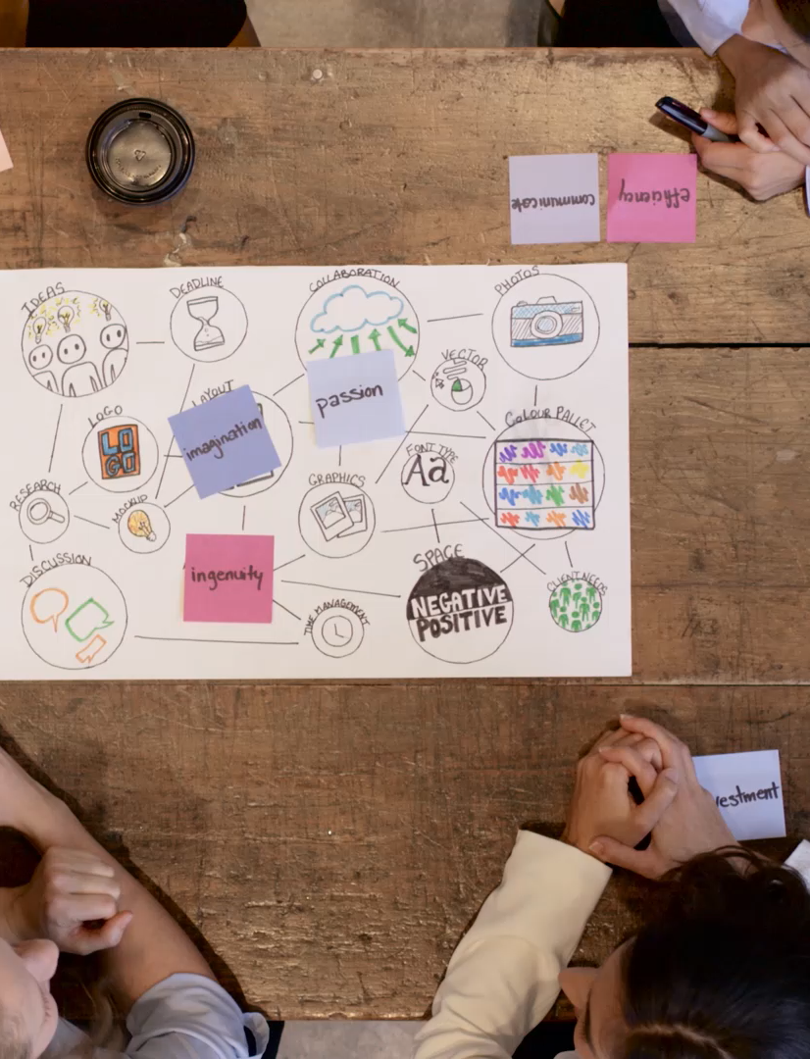
2025
By embracing these principles, study groups can effectively enhance comprehension, retention, and collaborative skills, ultimately leading to a more meaningful and impactful learning experience.

Slide 16
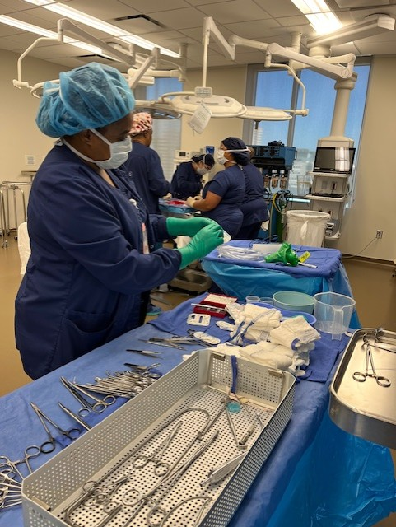
Students discussing counting
By embracing these principles, study groups can effectively enhance comprehension, retention, and collaborative skills, ultimately leading to a more meaningful and impactful learning experience

Slide 17
Diverse Perspectives
Group settings enable students to encounter different viewpoints, which can challenge their thinking and broaden their understanding of a subject.
Paradigms

Slide 18
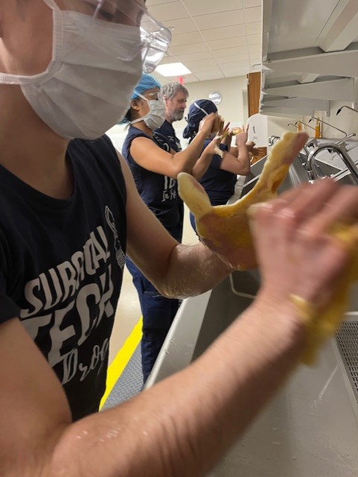
Diverse perspectives within study groups enrich the learning experience and foster critical thinking. When students come together from varied backgrounds, cultures, and academic experiences, they bring unique insights and approaches to problem-solving. This diversity encourages a richer dialogue and deeper exploration of topics.
2025

Slide 19
Key benefits of incorporating diverse perspectives include:
2025
Enhanced Critical Thinking: Exposure to different viewpoints prompts students to reevaluate their assumptions and consider alternative interpretations, leading to more nuanced understanding.
Increased Creativity: A variety of perspectives can inspire innovative ideas and solutions, encouraging students to think outside the box and approach challenges from multiple angles.
Improved Collaboration Skills: Working with peers from diverse backgrounds helps students develop essential communication and collaboration skills, preparing them for future teamwork in both academic and professional settings.
Broader Knowledge Base: Engaging with differing opinions and experiences allows students to accumulate a wider range of knowledge, empowering them to participate in more informed discussions.

Slide 20
Diverse Perspectives
2025
By valuing and leveraging diverse perspectives, study groups not only enhance individual learning but also cultivate an inclusive environment where all voices contribute to collective growth.

Slide 21
Peer Support
2025
Study groups can facilitate emotional and motivational support among peers, creating a sense of community that can enhance motivation and reduce feelings of isolation.
Paradigms

Slide 22
Study Groups can lead to lifelong friends
2025
The Pact: Three Young Men Make a Promise and Fulfill a Dream
https://www.goodreads.com/book/show/783956.The_Pact?from_search=true&from_srp=true&qid=WExQhJ3n8T&rank=1
https://www.barnesandnoble.com/w/the-pact-sampson-davis/1102717059

Slide 23
Active Learning Strategies
2025
Group activities can include discussions, problem-solving sessions, and peer teaching, which are all effective strategies for reinforcing learning.
Paradigms

Slide 24
What’s the Solution
2025
What changes can you make to help you and your students be more successful?
    expectations
    email communication
    office hour communication
    self-management

Slide 25
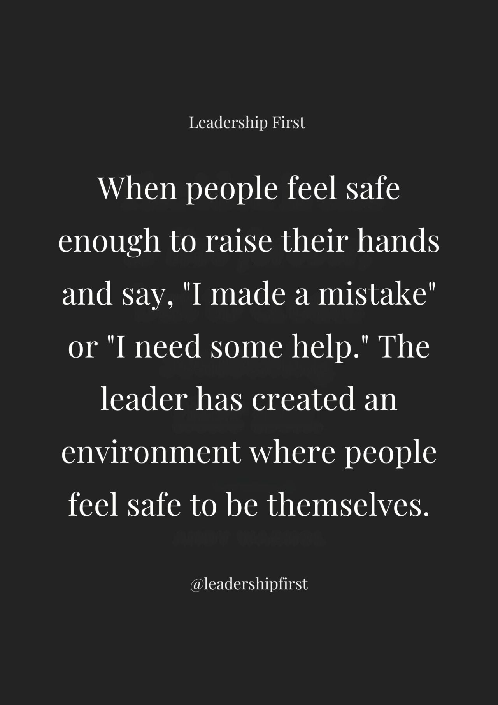
PICTURE SLIDE
2025

Slide 26

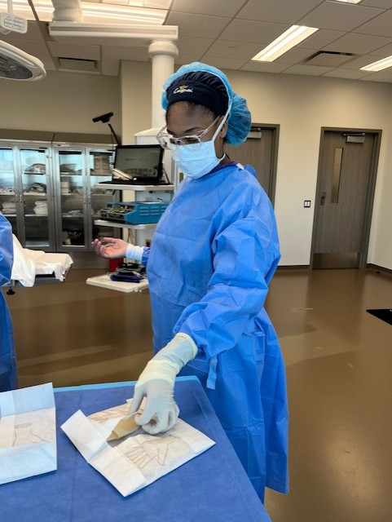
2025
Change a contaminated glove practice

Slide 27
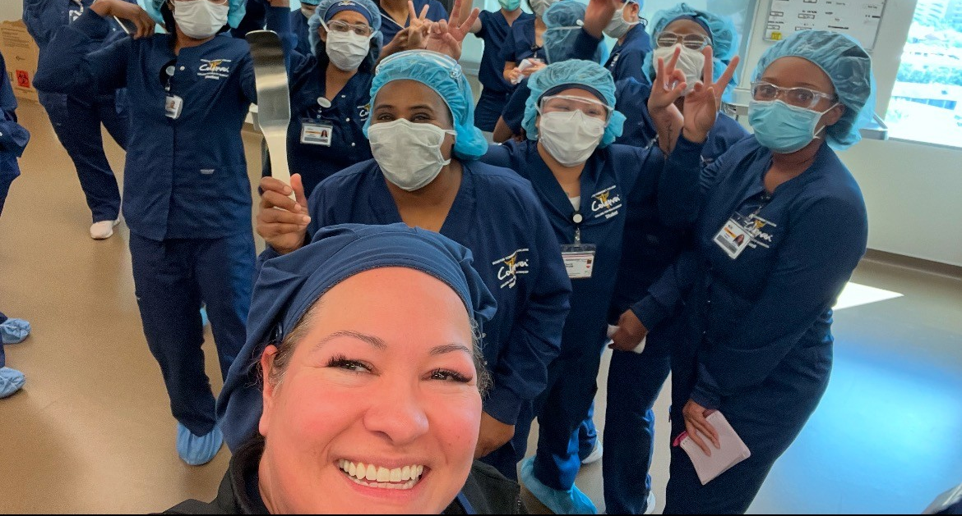
THANK YOU!
2025
Paulette Bee and Melissa Bruton
2025

Slide 28

References
2025
Cathryn “Cat” Jeffers-Goodwine
c.jeffersgoodwine@hccs.edu

